Slide 1
Hydraulic injection injury toolbox talk
Notes:
Other available resources:
Health & Safety Laboratory report – rr976
http://www.hse.gov.uk/research/rrpdf/rr976.pdf
HSE safety bulletin:
http://www.hse.gov.uk/safetybulletins/hydraulic-injection-injury.htm
Safety in pressure testing:
http://www.hse.gov.uk/pubns/gs4.htm

Slide 2
Objectives
Understand the potential outcomes of a pressure related failure.
Understand the risks associated with hydraulic injection.
Be aware of the seriousness of hydraulic injection injuries.

Slide 3
What is hydraulic injection injury?

Slide 4
Hydraulic injection injury
Hydraulic Injection: puncturing of the epidermis by a jet of liquid under pressure
Hydraulic Injection Injury: the physical injury arising from hydraulic injection
Notes:
Injection injury is usually oil (most commonly hydraulic injury) but can be anything under a very high pressure. High pressure water is a potential problem and high pressure water jetting can be a significant risk. Paint and paint thinners also feature highly in the list of substances involved. HSE has investigated fatalities where water jetting has been taking place and the jet has inadvertently been pointed at people nearby.
There is no universally agreed figure at which fluid can pierce the skin, but it is generally thought that 100psi with the skin in close proximity to the source can be enough and can occur up to 100mm from the fluid source.
Hydraulic fluids in hoses etc, pressure can range from 600psi – 12,000psi.

Slide 5
Hydraulic injection injury
Almost entirely occupational
Male manual workers
Skilled and unskilled
Pads of the fingers or palm of the hand
Notes:
Most commonly tend to be firemen using hydraulic cutting equipment. Their priority is the preservation of life so the careful manoeuvring of equipment across a road perhaps littered with glass etc, may not be the first concern.
Farmers/agricultural workers involved with high pressure equipment have also been affected with hoses between tractor & trailer becoming damaged.
Plant maintenance and leaking machinery – handling of hydraulic hoses also all potential areas where this can occur.
Usually identified as a result of a oil pooled, or damp patch/dirty marking on surface near hydraulic hoses.

Slide 6
Hydraulic injection injury
Benign initial presentation
Feels like a small electric shock
Notes:
Fairly insignificant initial injury – potential of the injury may not be appreciated at the time and any delay to seek medical intervention can prove significant.
Can present itself as a small cut, blister etc. The sort of injury you may pick up during a routine manual working day as you will see from the following slides.

Slide 7
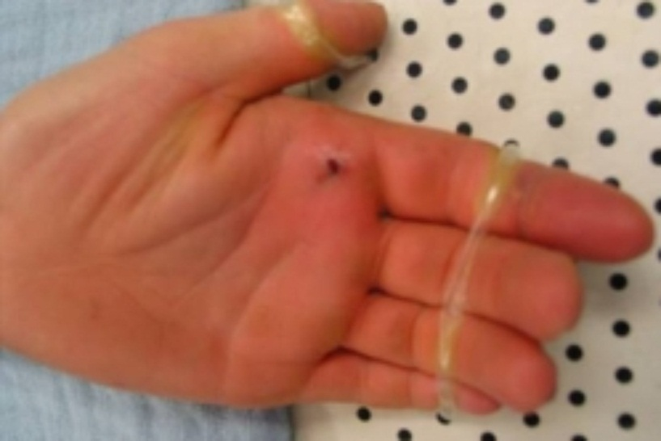
Initial injury appearance (after 24 hours)
Notes:
Example of initial injury. Shows why there can be a problem with identifying the potential seriousness of the injury.
Pain & swelling may not appear for several hours, perhaps days, after injection.

Slide 8
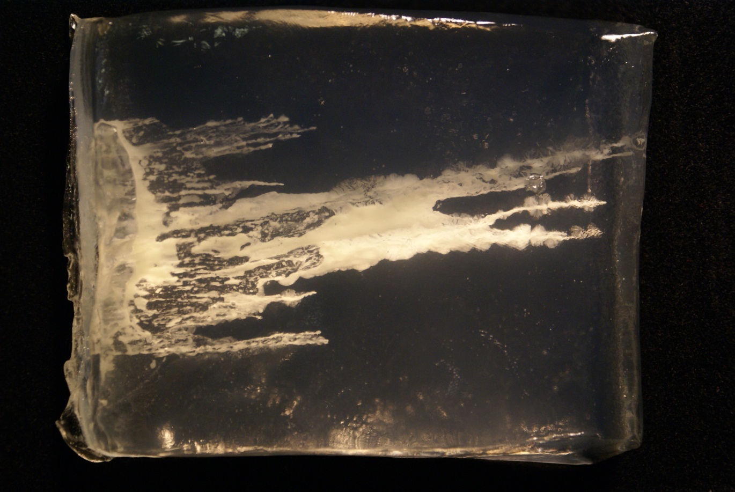
Showing effects of the fluid injection in ballistic gel to replicate under the skin
Notes:
Picture shows the under skin effects of fluid injection into the skin and how far it can penetrate below the skin surface.
Also shows the ‘compartmentalisation’ effect, with the fluid spreading into compartments below the skin and then bursting through the other side. Better picture on next slide

Slide 9
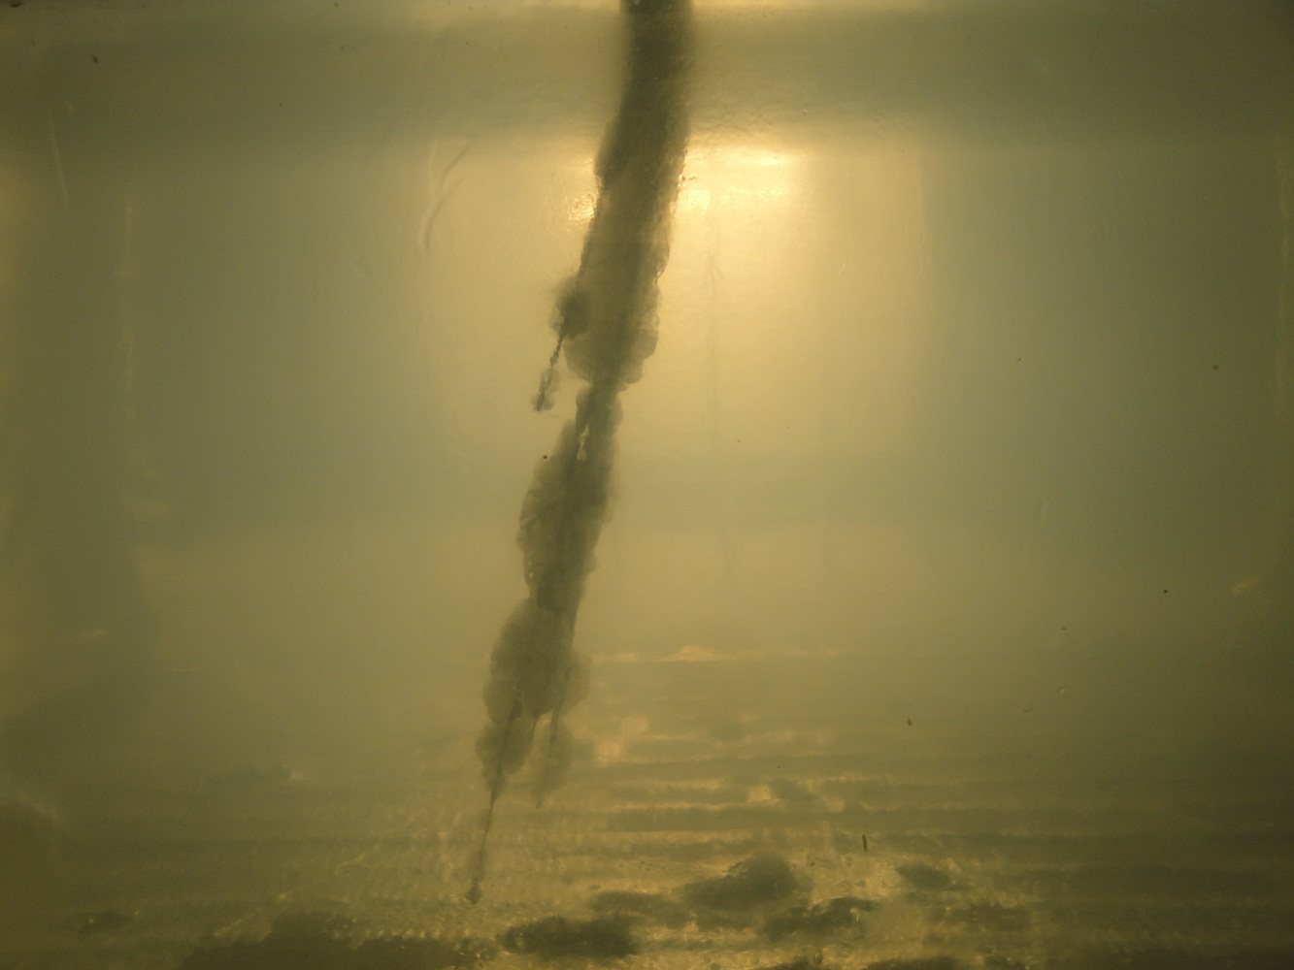
Example of the ‘compartmentation’ effect when fluid is injected into the skin
Notes:
Better image showing the compartmentalisation effect – clearly showing 3 separate areas into which the fluid has spread.

Slide 10
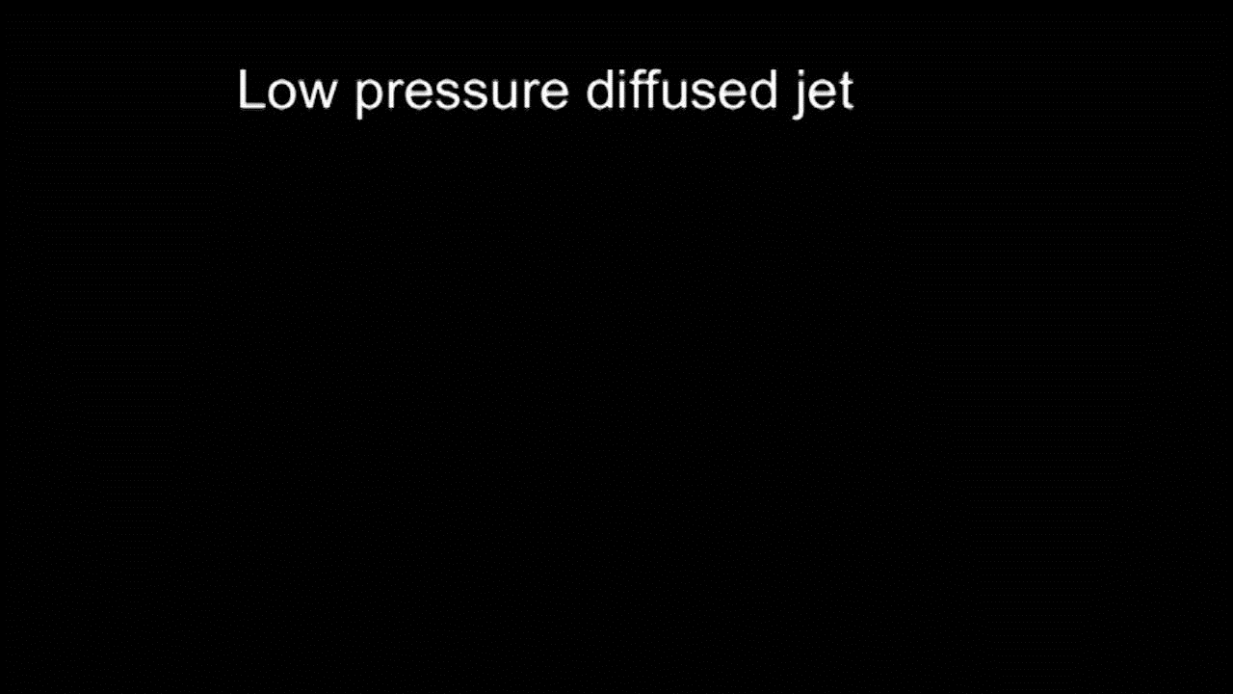
Hydraulic Injection injury – low pressure diffused jet – calf’s leather
Notes:
Video showing the effect of a low pressure diffused jet on a skin substitute – calf’s leather. No penetration through the material.

Slide 11
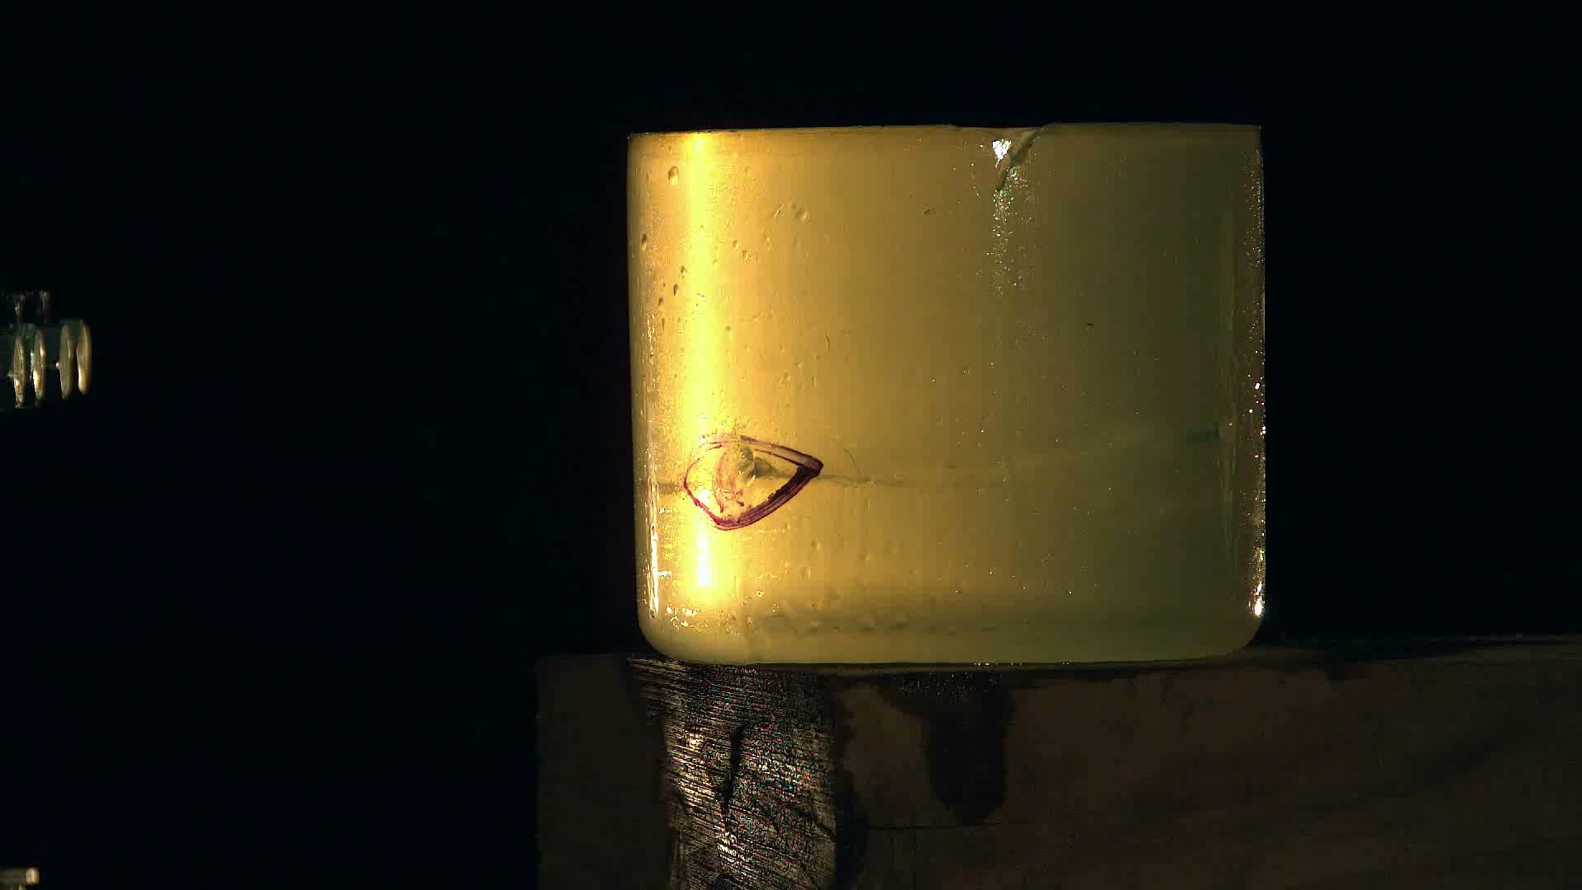
Hydraulic Injection injury – low pressure diffused jet – ballistic gel
Notes:
Same jet, nozzle and proximity from the gel. Again, showing no ingress into the skin.

Slide 12
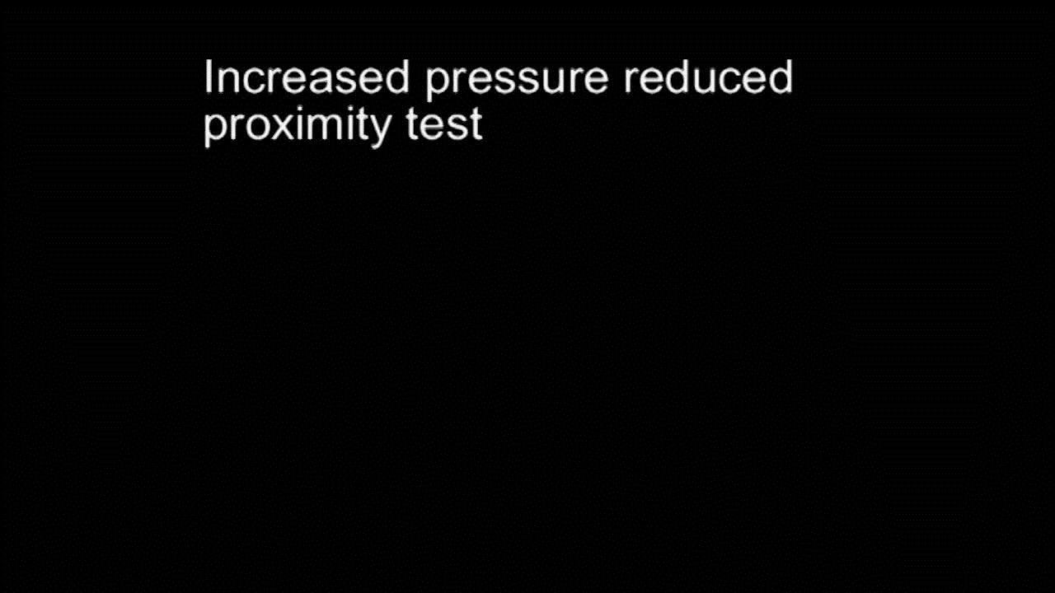
Hydraulic Injection injury – high pressure jet – calf’s leather
Notes:
With the pressure increased and the proximity reduced, the fluid is capable of piercing the calf’s leather.
In practice, many instances of hydraulic injection injury have occurred when the skin (mostly hands/fingers) is actually on the high pressure hosing itself.
Has been common for people to identify leaking hoses by running hands along the hose trying to establish the leak location – this is VERY bad practice and should not take place.

Slide 13
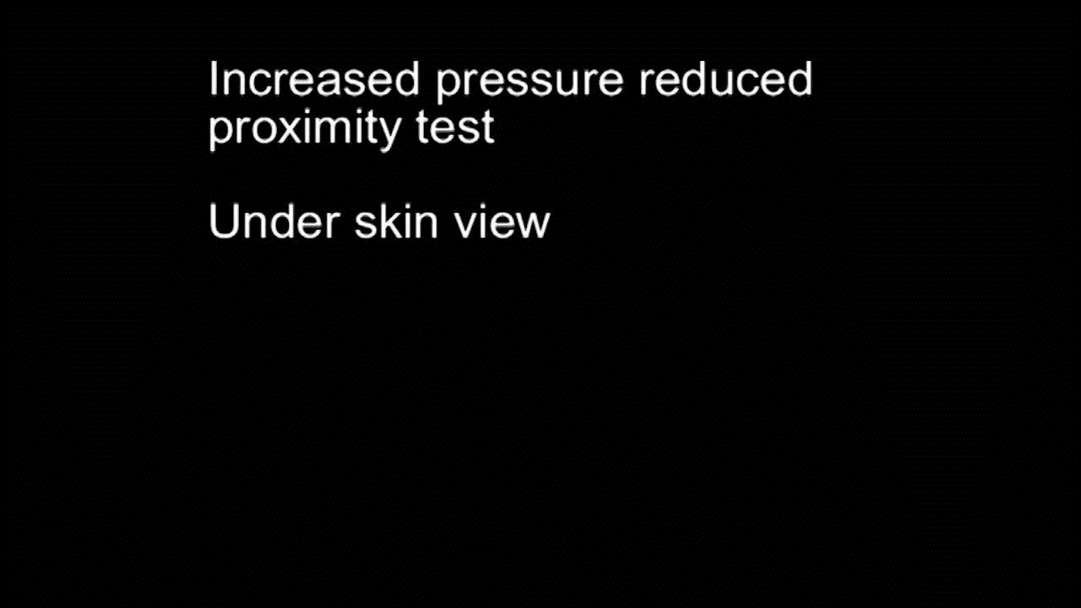
Hydraulic Injection injury – low pressure diffused jet – calf’s leather under skin view
Notes:
Same videos as previously, but with view from underneath.

Slide 14
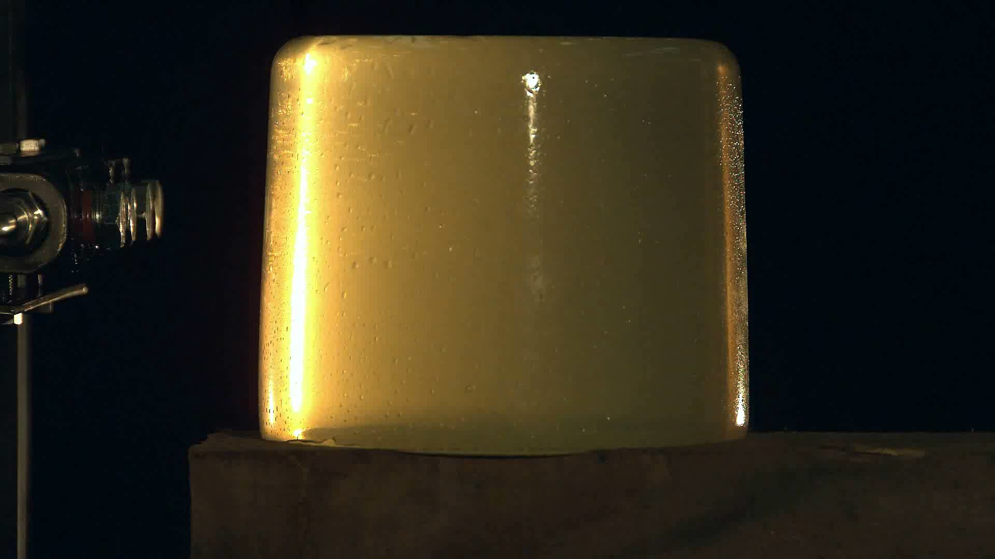
Hydraulic Injection injury – high pressure – ballistic gel – slow motion
Notes:
Slow motion video of fluid entering ballistic gel.

Slide 15
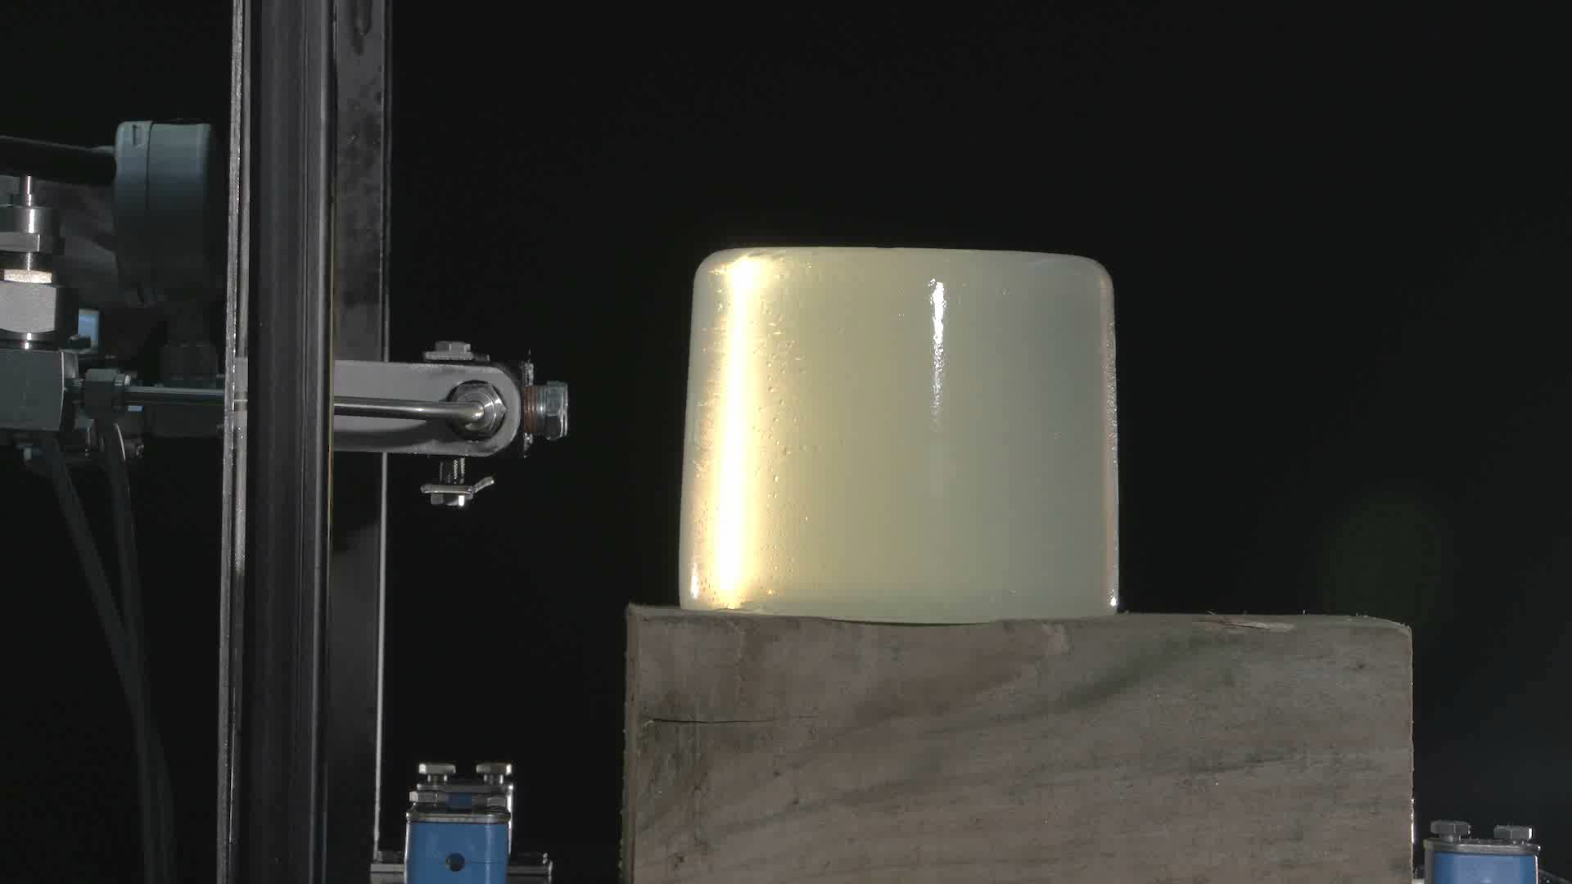
Hydraulic Injection injury – high pressure – ballistic gel – real time
Notes:
Shows injury in real-time. May help to answer questions as to why people don’t move their hands away when they feel something – very little time to do so and by the time they have, the fluid is already in the system.

Slide 16
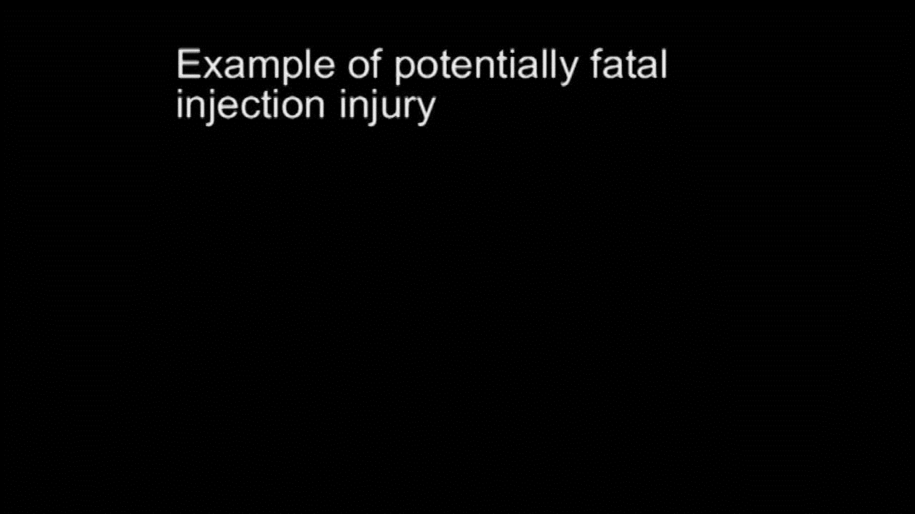
Hydraulic Injection injury – high pressure jet – example of potentially fatal injury
Notes:
Ballistic gel in shape of head – can clearly be seen how far into the skull the fluid travels.

Slide 17
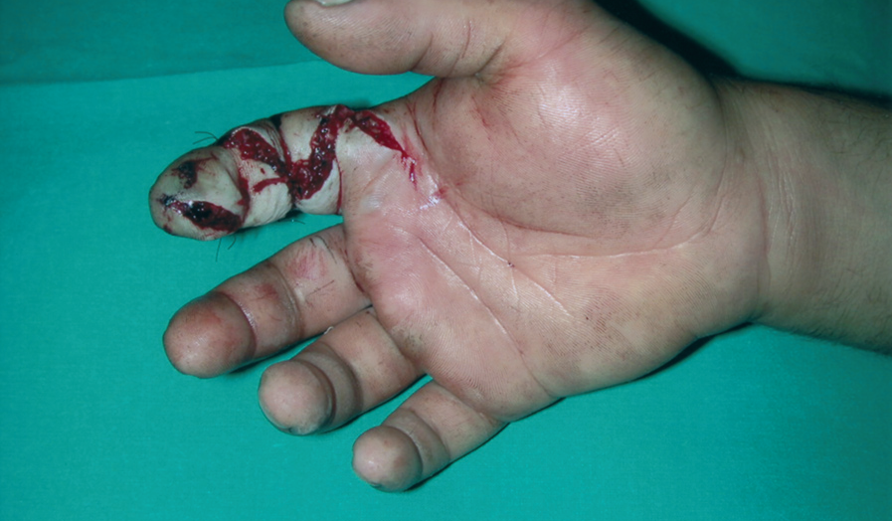
The progression of an injection injury
Notes:
Injection into end of index finger causing the seen damage. Hydraulic oil is also toxic and has a necrotising effect, so caused the skin to die which can be seen more clearly in the next slide.
Gangrene can set into the injury if not treated properly and there is also a risk from blood poisoning and bacterial infection.

Slide 18
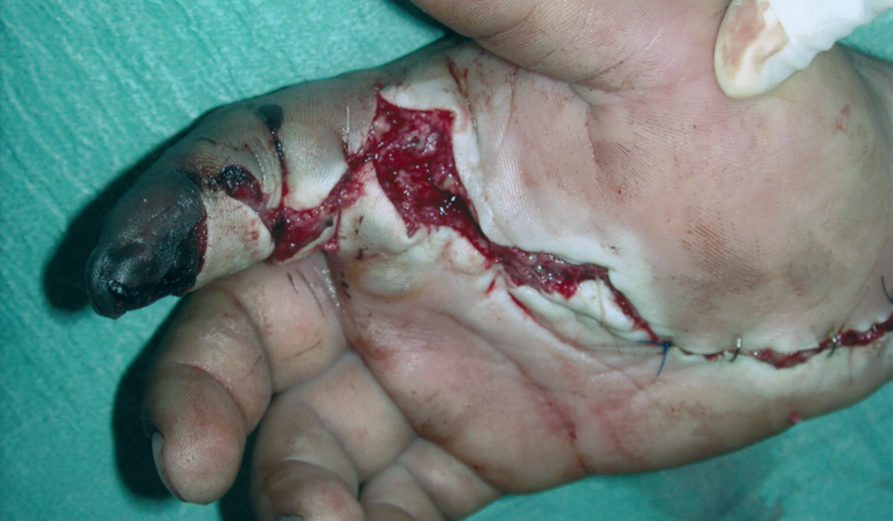
The progression of an injection injury
Notes:
Black area of dead skin can be seen and the travel of the fluid “wicking” along the blood vessels can also be seen down the finger and along the palm.

Slide 19
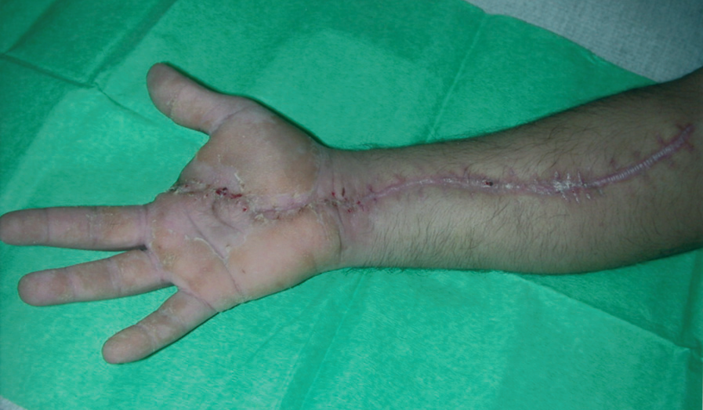
The progression of an injection injury
Notes:
Final picture showing the full impact of the injection injury. Has caused the index finger to be removed, but also significant levels of surgery along the arm to remove the necrotised skin which is the only option – called surgical debridement.
The severity of the injury depends upon several factors:
• Type of fluid injected into the body
• Amount of fluid injected
• Pressure of fluid injected
• Presence of toxins or bacteria within the fluid
• Degree of spread of injected fluid within the body
• Time between injection and surgical treatment. (This is the most important factor – the sooner the surgical treatment the less long-term disability will result)

Slide 20
Hydraulic injection injury
Occurs where there has been a
Functional failure; where a piece of equipment stops working completely following catastrophic component failure.
Material failure; where a small leak has occurred but the equipment remains operational.

Slide 21
Hydraulic injection injury
Preventative measures include:
Leak detecting (with an instrument/tool/mirror etc)
General maintenance
Replacement of fittings and hoses
Commissioning/bleeding
Notes:
Safe systems of work should be implemented where high pressure is being used, including segregation.
Using tool for leak detection most effective – keep hands/fingers out of the way. Mirror, cardboard, piece of paper etc…anything that might show up a spray of oil would be effective.
Other measures are general maintenance and end-of-life replacement of susceptible parts of the system.
Pressure systems should, if possible, be locked off, isolated and de-energised before maintenance takes place.
Hydraulic hoses should be protected against damage that might cause the pinholes in the hoses that lead to injection injury and a formal inspection and maintenance regime put in place.

Slide 22
Hydraulic injection injury
Raising awareness
Tool box talks
Introduction of physical barriers
Reducing proximity to equipment
PPE (last resort & limited effectiveness)
Notes:
PPE is always a last resort but some manufacturers of high pressure hoses have produced some. It is generally difficult for PPE to be effective in all situations due to the variance in pressure levels of fluids and potential proximity to the source of the leak.

